Slide 1

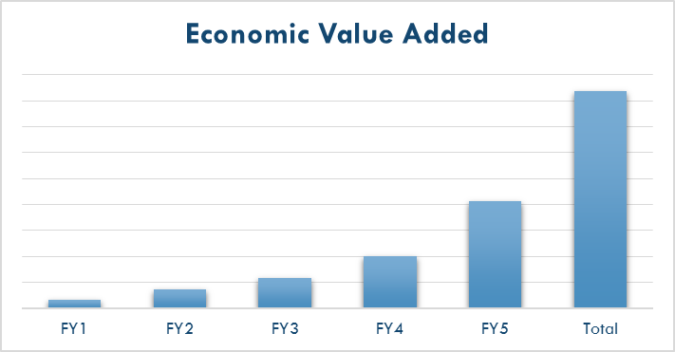

Create a Financial Model Training & Excel Templates
Confidential
By Former Deloitte Management Consultants

Slide 2


Objectives of this document
Learn how to create a Financial Model with a Powerpoint training and Excel template created by former Deloitte Management Consultants
Save your time by using our fully editable PowerPoint slides and Excel sheets
Aurelien Domont
Slidebooks Consulting
Managing Director

Slide 3

Table of Contents
What is Financial Modeling?
How to plan and design an Excel Financial Model?
How to build an Excel Financial Model?
What are the key formulas to use in your Financial Model?

Slide 4
Table of Contents
What is Financial Modeling?
How to plan and design an Excel Financial Model?
How to build an Excel Financial Model?
What are the key formulas to use in your Financial Model?

Slide 5
Financial modeling definition
Definition
Financial modeling is the task of building an abstract representation of a real world financial situation
This abstract representation is called a financial model
A financial model is designed to represent a simplified version of the performance of a financial asset, a project, or any other investment
A financial model is generally build around financial statements such as the income statement, the balance sheet and the cash flow statement
The most commonly tool used to build a financial model is Excel

Slide 6
Table of Contents
What is Financial Modeling?
How to plan and design an Excel Financial Model?
How to build an Excel Financial Model?
What are the key formulas to use in your Financial Model?

Slide 7
Ensure that you are clear about your goal
Switch off your computer
Define the question your financial model needs to answer
Identify the blank slides in your storyline that will have to be completed by your financial model outputs sheet(s)
Identify what will not be solved by your model
Create and agree on a work plan
Do a back of the envelope calculation to give you an idea of the final answer

Slide 8
Draw out a driver tree
Example
Increase revenues
Increase price
Increase volume
Increase
gross profit
Improve product mix
Decrease manufacturing
costs
Improve process
Reduce cost of inputs
Increase net
Operating profit less adjusted
Taxes (NOPLAT)
Improve plant utilization
Reduce selling
costs
Increase productivity
Decrease staffing
Optimize scheduling
Decrease operating
expenses
Reduce distribution
costs
Optimize physical network
Decrease staffing
Company Value Creation
Reduce administrative
costs
Use alternative distribution
Lower Customer Service costs
Reduce R&D costs
Lower support functions costs
Improve capital investment
Improve capital
allocation
Capital
deployment
Reduce inventories
Reduce Accounts receivable
Increase Accounts payable
Cost of
capital
N/A

Slide 9
Identify what should be inputs, calculations and outputs
Outputs
Calculations
Inputs
Your text
Your text
Your text
Your text
Your text
Your text
Your text
Your text
Your text
Insert your text
Your text
Your text
Your text
Your text
Your text
Your text
Your text
Your text
Your text
Your text
Your text
Your text
Your text

Slide 10
Draw out a schematic for how the spreadsheet will work
Inputs sheet
Calculation sheets
Outputs sheet
Inputs sheet #1
Calculation sheet #1
Calculation sheet #2
Outputs sheet #1

Slide 11
Table of Contents
What is Financial Modeling?
How to plan and design an Excel Financial Model?
How to build an Excel Financial Model?
What are the key formulas to use in your Financial Model?

Slide 12

Financial model structure
An effective Excel financial model should have the following structure:
1
2
3
4
5
6
Project Description sheet
Worksheet Description
Worksheet Flow
Inputs sheet(s)
Calculation sheet(s)
Outputs sheet(s)

Slide 13
1.The Project description sheet should include:
✓
The project name
✓
The name of the scenario
✓
A brief description of the project
✓
The model version
✓
The file name
✓
The name of the persons who prepared and reviewed the model
✓
The names of project sponsor and the project leader

Slide 14
1.Project description sheet Excel template
Double click to access the editable Excel spreadsheet

Slide 15
2.The Worksheet description should include:
✓
The Financial model purpose
✓
A worksheet overview with the name, the type and the description of each sheet
✓
If required, some guidance on how works each sheet
✓
The colour codes and formatting conventions used in the financial model

Slide 16
2.Worksheet description Excel template
The editable version of this Excel spreadsheet was part of your purchase

Slide 17
3.The Worksheet Flow should include:
✓
A visual representation of the inputs sheet, calculations sheet(s) and outputs sheet(s)
✓
The relationship between each sheet of the document
✓
Links towards each sheet of the document in order to facilitate the navigation

Slide 18
3.Worksheet Flow Excel template
The editable version of this Excel spreadsheet was part of your purchase

Slide 19
4.The Inputs sheet should include:
✓
Your company standard assumptions:
Assumptions that are used to assess all the projects of the company
✓
Your static assumptions:
Assumptions specific to your project and constant over the whole modeling period (e.g. tax rate)
✓
Your dynamic assumptions:
Assumptions specific to your project and changing over the whole modeling period (e.g. growth rate)
✓
The source and updated date of all assumptions
✓
The possibility to select your scenario

Slide 20
4. Inputs sheet Excel template
The editable version of this Excel spreadsheet was part of your purchase

Slide 21
5.The Calculation sheet(s) should include information such as:
✓
The calculation of the revenue generated by the project
✓
The calculation of the cost savings generated by the project
✓
The calculation of the project operational expenditure (OPEX)
✓
The calculation of the project capital expenditure (CAPEX)

Slide 22
5.Calculation sheet Excel template:
The editable version of this Excel spreadsheet was part of your purchase

Slide 23
6.The Outputs sheet(s) should include information such as:
✓
Total add revenue and cost savings
✓
Total add operational expenditure
✓
Taxes and net income
✓
Change in WC, capital expenditures, operating free cash flow
✓
Present value, cumulative present value and net present value
✓
IRR, payback period, payback period discounted

Slide 24
6.Outputs sheet template
The editable version of this Excel spreadsheet was part of your purchase

Slide 25
Table of Contents
What is Financial Modeling?
How to plan and design an Excel Financial Model?
How to build an Excel Financial Model?
What are the key formulas to use in your Financial Model?

Slide 26
A Financial Model essentially uses the following 12 formulas
TRIM
LOWER
UPPER
PROPER
LEFT
RIGHT
MID
&
ROUND
ROUNDUP
ROUNDOWN
MATCH
INDEX
MATCH AND INDEX COMBINED
SUMPRODUCT
IF
SUMIF
INDIRECT
ADDRESS

Slide 27
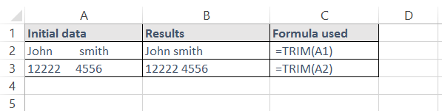
TRIM
Description
The TRIM function removes all spaces between words and numbers except for single spaces
It is used to clean up data and ensure consistency
Syntax
=TRIM(text)
Example

Slide 28
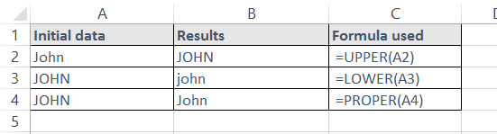
LOWER / UPPER / PROPER
Description
These text functions change the capitalisation of text to either all lower case, all capitals, or first letter upper case and all other letters lower case
Syntax
=UPPER(Text)
=LOWER(Text)
=PROPER(Text)
Example

Slide 29
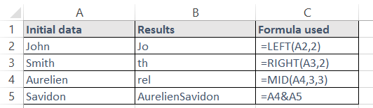
LEFT / RIGHT / MID / &
Description
These functions are used to manipulate and combine text and numbers
Syntax
=LEFT(Text, Number of characters to be provided)
=Right(Text, Number of characters to be provided)
=Mid(Text, Initial character to count from, Number of characters to be provided)
=CellX&CellY
Example

Slide 30
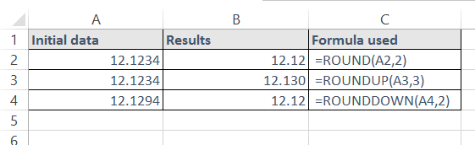
ROUND / ROUNDUP / ROUNDOWN
Description
These functions round your number according to the conditions you specify
Syntax
=ROUND(Number to be rounded, Number of digits)
=ROUNDUP(Number to be rounded, Number of digits)
=ROUNDDOWN(Number to be rounded, Number of digits)
Example

Slide 31
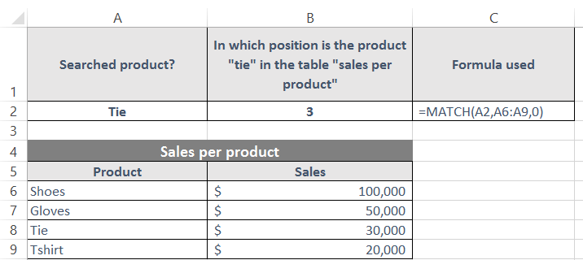
MATCH
Description
The MATCH function looks for an item in a list, and returns its position in the list
It can be used for both text and numbers
The function can look for an exact or approximate match
Syntax
=MATCH(WhatToLookFor,WhereToLook,TypeOfMatch)
WhatToLookFor – The value to search for
WhereToLook – The range of values to search in
TypeOfMatch – Either 0, 1 or -1
0 – Looks for an exact match
1 – Looks for an exact match, or the next lowest number if no exact match exists
-1 – Looks for an exact match, or the next highest number of no exact match exists
Example

Slide 32
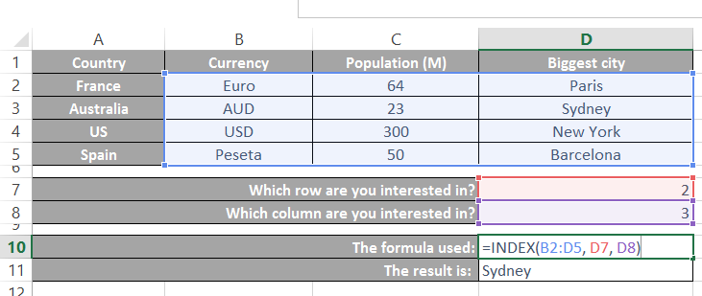
INDEX (1/2)
Description
The INDEX function picks a value from a range of data by looking down a specified number of rows, and then across a specified number of columns
It can be used with a single block of data, or non-continuous blocks
Syntax
=INDEX(RangeToLookIn,RowCoordinate,ColumnCoordinate)
RangeToLookIn – The range of cells to look in
RowCoordinate – The row coordinate to look for
ColumnCoordinate – The column coordinate to look for
Example

Slide 33
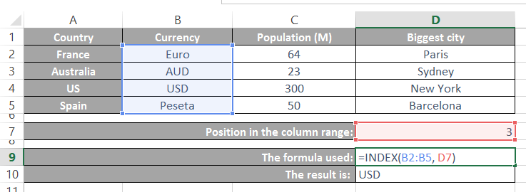
INDEX (2/2)
Description
The INDEX function can also be used with 1 coordinate instead of 2. In that case the RangeToLookIn needs to be either a single column or row
Syntax
=INDEX(RangeToLookIn,Coordinate)
Example

Slide 34
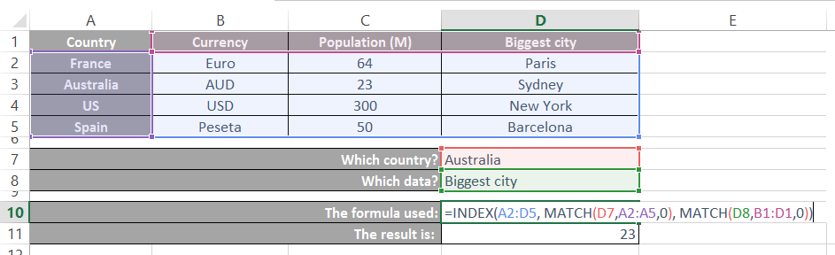
INDEX & MATCH combined
Description
INDEX and MATCH can be used together to look up a value from a table
2 MATCH functions are used to return both the row and column coordinates of the value
Then an INDEX function is used to look up the value from the table
Syntax
=INDEX(DataRange,MATCH(RowLookup,RowRange,0),MATCH(ColLookup,ColRange,0))
DataRange – The data range to look in
RowLookup – The row name to lookup
RowRange – The data range containing row names
ColLookup – The column name to look up
ColRange – The data range containing column names
Example

Slide 35
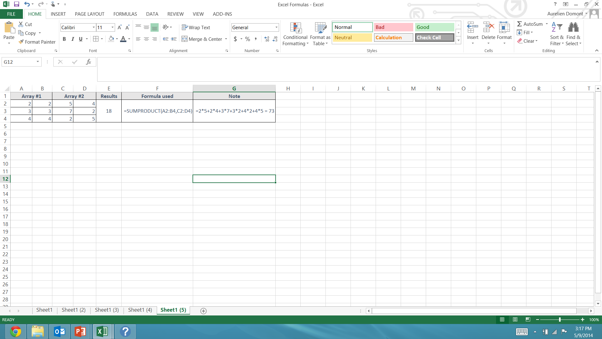
SUMPRODUCT
Description
Multiplies corresponding components in the given arrays, and returns the sum of those products
Syntax
=SUMPRODUCT(array1, array2,...)
Example

Slide 36
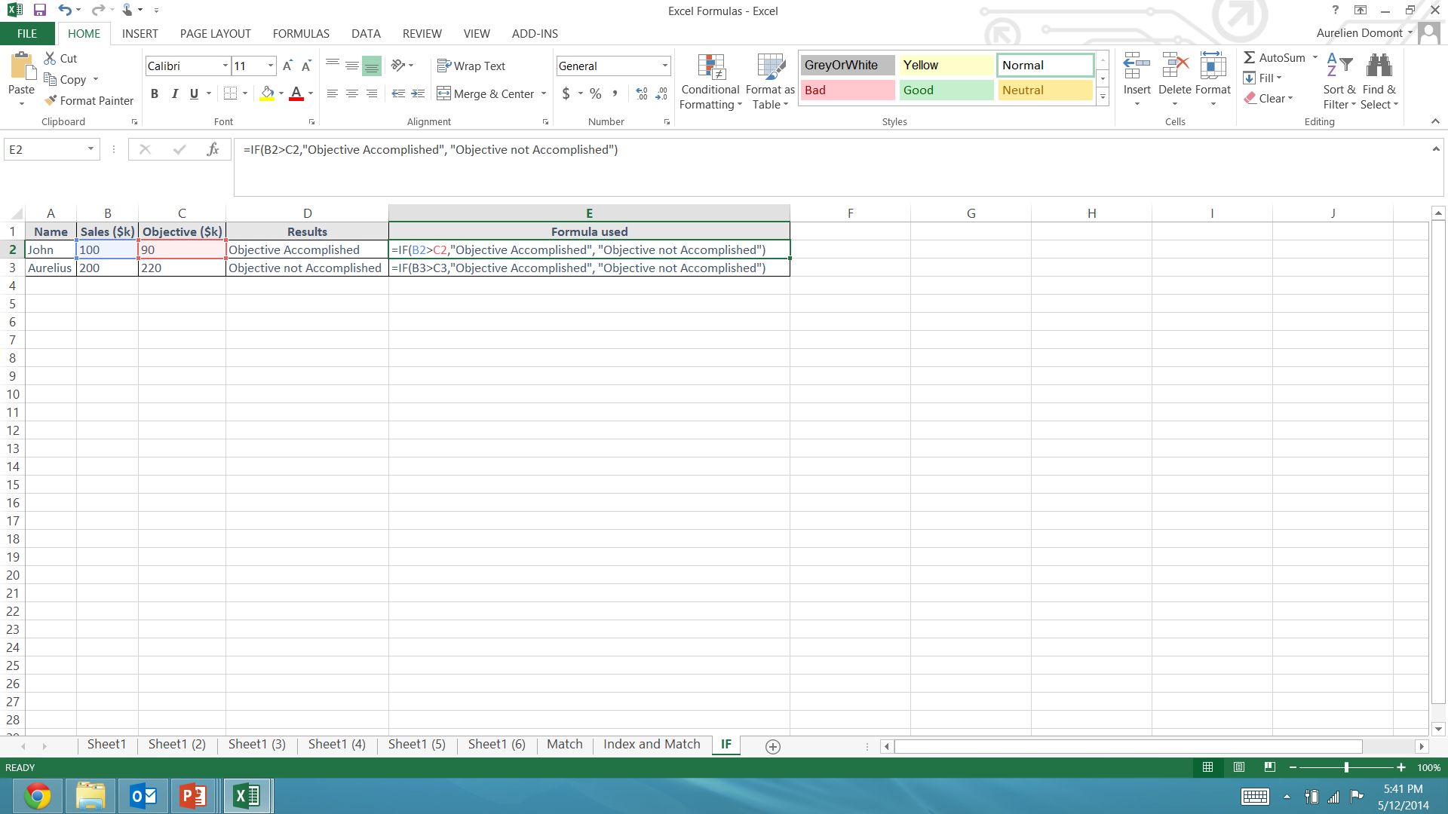
IF
Description
This function “IF” tests a condition
If the condition is met it is considered to be TRUE
If the condition is not met it is considered as FALSE
Depending upon the result, one of two actions will be carried out
Syntax
=IF(Condition, Action If True, Action If False)
The Condition is usually a test of two cells, such as A1=A2.
The “Action If True” and “Action If False” can be numbers, text or calculations
Example
The formula “IF” indicates in the column D who has reached his objective:

Slide 37
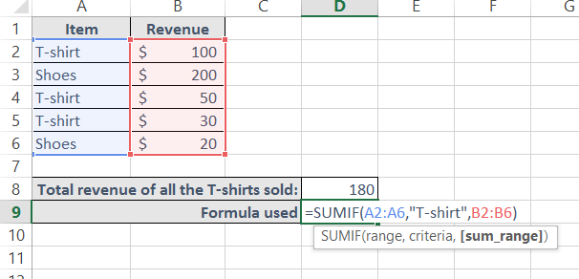
SUMIF
Description
This function sums the value of items which match the criteria set by the user
Syntax
=SUMIF(RangeOfThingsToBeExamined,CriteriaToBeMatched,RangeOfValuesToTotal)
Example
The formula “SUMIF” indicates in the Cell D8 the total revenue of all the t-shirts sold:

Slide 38
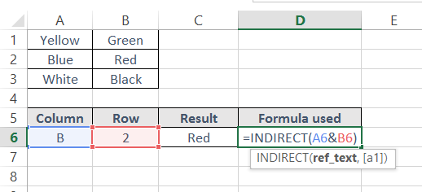
INDIRECT
Description
This function returns the contents of a cell, given the cell reference
Be careful if a cell is moved, or a new row is inserted, the cell references will not automatically update
Syntax
=INDIRECT(CELLREF)
Example
The INDIRECT formula returns in C6 the content of the cell B2

Slide 39
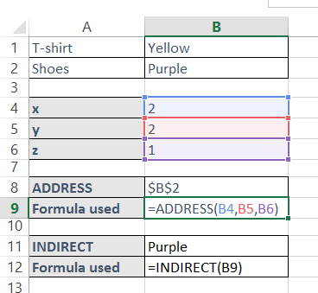
ADDRESS
Description
The address function returns the reference of a cell, given numerical coordinates.
This allows the cell reference to be modified by performing operations (i.e. add or subtract) in the numerical co-ordinates
Syntax
=ADDRESS(x,y,z)
x and y are integers that describe the co-ordinates of a cell (i.e. ADDRESS(1,1) will return “A1”
z is an integer, between 1 and 4, which determines whether absolute or relative referencing is used, i.e.
Z | Definition | Example
1 | Absolute | $A$1
2 | Relative column / Absolute row | A$1
3 | Absolute column / Relative row | $A1
4 | Relative | A1
Example
The ADDRESS formula returns the cell ref $B$2
The INDIRECT formula returns the content of the cell B2

Slide 40









Interested in more Business & Consulting Toolkits? Our ex-McKinsey, Deloitte & BCG Consultants created 10 Toolkits including practical Frameworks, Tools & Templates
1.Corporate & Business Strategy Toolkit
2.Management Consulting Toolkit
3.Change Management Toolkit
4.Project Management Toolkit
5.Sales, Marketing & Communication Toolkit
Visit Website
Visit Website
Visit Website
Visit Website
Visit Website
6.Finance and Mergers & Acquisitions Toolkit
7.Digital Transformation Toolkit
8.Operations & Supply Chain Toolkit
9.Leadership Skills Toolkit
10.Legal Toolkit
Visit Website
Visit Website
Visit Website
Visit Website
Visit Website

Slide 41

Interested in multiple Business & Consulting Toolkits? Get access to all our Toolkits for half the price with the Gold Business & Consulting Package
Gold Business & Consulting Package
Learn More
www.slidebooks.com

Slide 42



Need more help? Hire one of our Management Consultants for $4,000 a day
Learn More

Slide 43
Thanks for your attention!
www.slidebooks.com

